Slide 1


Slide 2
Key Findings & Analysis – Predictive Customer Bookings
IMBALANCED DATA (All features)
Models | ROC-AUC Score | F1 score
Logistic Regression | 50% | 0%
Random Forest | 51% | 6%
XGBoost | 50% | 0%
BALANCED DATA – AFTER SMOTE (All features)
Logistic Regression | 60% | 60%
Random Forest | 90% | 89%
XGBoost | 84% | 82%
BALANCED DATA – AFTER SMOTE ENN (All features)
Logistic Regression | 62% | 74%
Random Forest | 93% | 94%
XGBoost | 84% | 86%

Slide 3
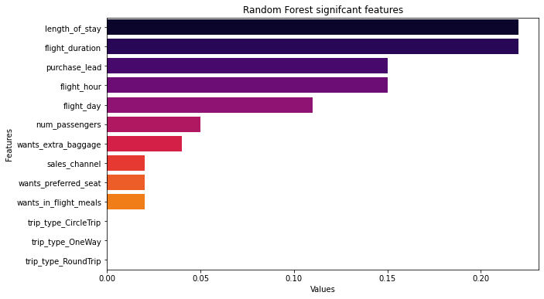
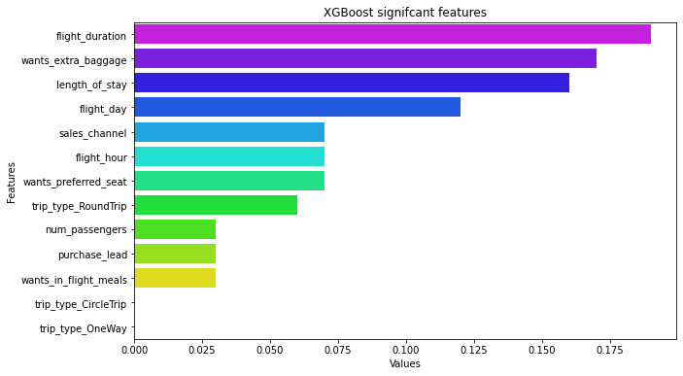
Key Findings & Analysis – Predictive Customer Bookings
BALANCED DATA – AFTER SMOTE ENN (7 features)
Models | ROC-AUC Score | F1 score
Random Forest | 90% | 91%
XGBoost | 84% | 86%

Slide 4
Conclusion
The dataset is highly imbalanced data.
Built, trained, tested & evaluated models with imbalanced data, results were poor.
Applied sampling techniques such as SMOTE & SMOTE ENN method to balance the dataset.
Both, resampled datasets yield better performance & results.
SMOTE ENN resampled data with random forest model gave better score at 93% ROC-AUC score & 94% F1 score having all features included.
Performed feature engineering techniques to extract significant features to overcome complexity & dimensionality issue.
The extracted significant features are num_passengers, purchase_lead, length_of_stay, flight_hour, flight_day, flight_duration, wants_extra_baggage, etc.
Finalised, Random Forest model with above 7 significant features which yield good score of 90% roc-auc & 91% f1.

Slide 5

Happy Journey!

